Slide 1
Nuclei polarizzati per la fusione nucleare controllata ed altre applicazioni
Dalla fisica alla medicina e di nuovo alla fisica

Slide 2
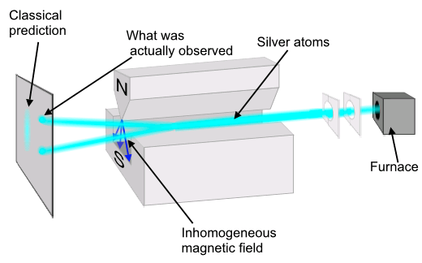
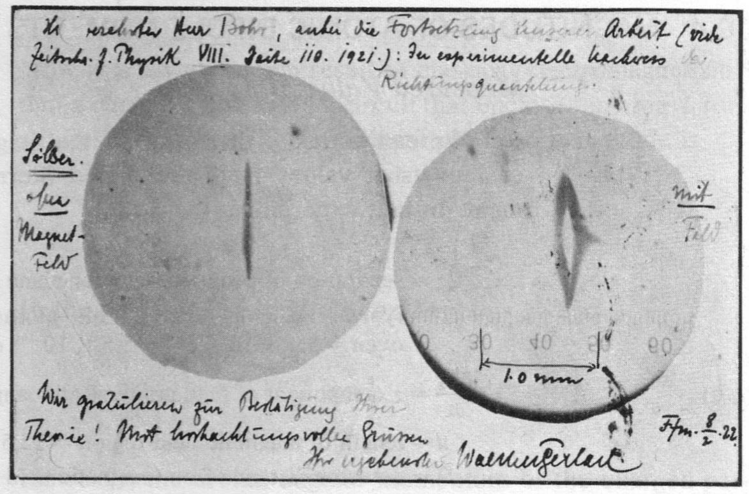
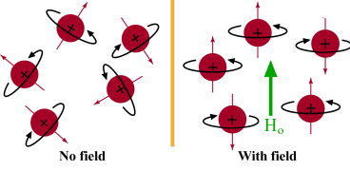
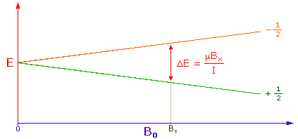
Lo spin: proprietà del microcosmo (particelle elementari)
Esperimento di Stern-Gerlach (1922): scoperta della quantizzazione del movimento rotatorio
Notes:
ABSTRACT
n the other hand, if the reactor is sufficiently marginal in its operation, then the application of polarization could lead to large savings and could even make fusion possible.
The mode most likely to be of benefit to a fusion device is the enhanced mode. We assume that the emission of the alpha particles perpendicular to the field does not appreciably decrease the alpha particle confinement during the transfer of the bulk of the alpha particle fusion energy to the plasma. The alpha particle heating is thus increased by 50%. The increase in alpha particle heating will make the startup and ignition of the plasma easier, since less external power is needed to raise the plasma to ignition temperatures. (This could also be advantageous for the proposed ignition experiment, the CIT.) The enhance- ment of the alpha particle energy reduces the temperature at which ignition occurs at a fixed density or, alternatively, it lowers the density needed for ignition at a given temperature. This means that less external power is required, even if the additional alpha particle power available near the critical temperature is not taken into account. The actual savings depend on the density and temperature dependence of the loss rates. If the required density is lowered by 1.5 through the reactivity enhancement, then the external power could be lowered by at least the same factor.
The possible gain from the employment of polarization during the main fusion cycle (after startup) depends very much on the limiting factors which control the cost of the reactor. If the reactor is not marginal, i.e. not limited by some specific process, then the gain to be achieved by increasing the amount of nuclear power should be modest. Some reduction of either the size or the magnetic field strength could be achieved without reducing the output power. It has been estimated that the actual savings in the cost of electricity would be from 5 to 10%. If the confinement time is the limiting parameter, then the confinement time necessary to achieve ignition could be lowered by a factor of 1.5 when polarization is used. If the critical plasma beta is important, then the beta at which ignition occurs could be reduced by using polarization. The amount of reduction in beta is determined by the dependence of the loss rates on density and temperature. The possible reduction ranges between 1.5 and (1.5)1/2 for various loss models.
If wall damage is a critical element in the cost of fusion, then some savings can be achieved by employing the unenhanced mode of polarization. This mode shifts some of the wall damage from the inner wall to the outer wall, as shown in Ref. [2].
The above considerations indicate that if polarization could be made to work, then it would be possible to select the proper mode of polarization to improve the performance of a fusion device, whatever the limiting physical factors are.

Slide 3
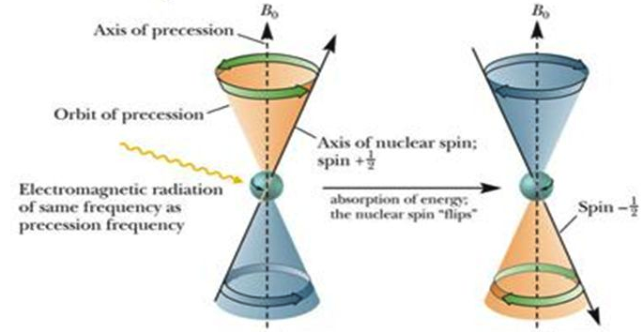
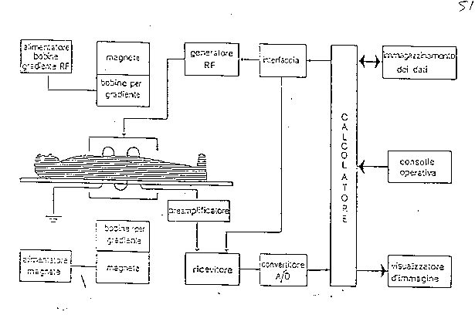
La risonanza magnetica nucleare (NMR)
In una misura convenzionale di NMR, il campione in esame viene posto in un campo magnetico altamente uniforme, ed una bobina esterna induce un campo a RF di frequenza tale da indurre spin-flip. Dopodichè il campo RF viene spento ed i nuclei dell’elemento chimico prescelto si riportano nella condizione iniziale di equilibrio termico, riemettendo un segnale RF di ampiezza proporzionale alla densità di nuclei nel campione. Questo è il segnale di NMR che viene rivelato da un’antenna e rielaborato da un computer
La presenza di uno o più gradienti di campo magnetico consente di suddividere il campione in tanti elementi di volume che risuonano ciascuno ad una particolare frequenza e quindi di effettuare una mappatura tridimensionale di densità del nucleo prescelto nel campione in esame.

Slide 4
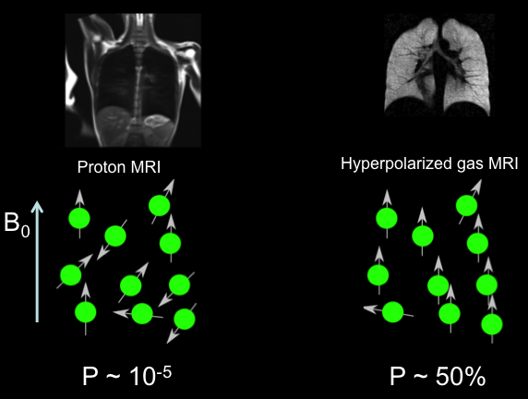
NMR con gas polarizzati: studi sulla funzionalità polmonare
Gas utilizzati: He-3 e Xe-129
Frequenza di risonanza per H₂ :
2μB/h ≈ 100 MHz ad B = 2.35 T
Frazione di nuclei di H₂ che contribuiscono
alla NMR ≈ μB/kT ≈ 8•10⁻⁶ = Polarizzazione P
Sufficiente per fornire un segnale misurabile!
La sensibilità dipende linearmente
dalla densità del materiale “risonante”.
Nel corpo umano: δ_{H} ≈ 2•10²² nuclei/cm³
Densità H gassoso a STP: 3•10¹⁸ nuclei/cm³
NMR con il gas non si può fare:
segnale troppo debole
A meno che il gas non sia polarizzato prima
con P quasi uguale a 1 (Gas iperpolarizzato)
asma, ostruzione polmonare cronica,
fibrosi cistica, danni da radiazione ecc.

Slide 5
La polarizzazione nella fusione nucleare
Un aumento di intensità della reazione di fusione nucleare in una miscela di gas ionizzati (plasma) magneticamente confinati può essere conseguito sfruttandone la dipendenza dall’orientazione mutua degli spin dei nuclei reagenti e relativa al campo magnetico in cui sono immersi.
Inoltre la direzione dei prodotti di fusione dipende dallo spin, così da permettere il controllo del trasferimento di energia dal plasma alle pareti del reattore oppure del flusso di neutroni verso aree ben precisate.
Kulsrud R.M. et al., Phys. Rev. Letters 49, (1982) 1248.
Kulsrud R.M. et al., Nucl. Fus. 26, (1986) 1443
Cowley S.C. et al., Phys. Fluids 29 (2), (1986) 430.
Coppi B. et al., Phys. Fluids 29 (12), (1986) 4060.
Kulsrud (PPL-Princeton):
“se un reattore è abbastanza marginale nella sua operazione, allora la polarizzazione dei nuclei reagenti può portare a considerevoli risparmi energetici e perfino rendere possibile la fusione stessa”
Notes:
ABSTRACT
n the other hand, if the reactor is sufficiently marginal in its operation, then the application of polarization could lead to large savings and could even make fusion possible.
The mode most likely to be of benefit to a fusion device is the enhanced mode. We assume that the emission of the alpha particles perpendicular to the field does not appreciably decrease the alpha particle confinement during the transfer of the bulk of the alpha particle fusion energy to the plasma. The alpha particle heating is thus increased by 50%. The increase in alpha particle heating will make the startup and ignition of the plasma easier, since less external power is needed to raise the plasma to ignition temperatures. (This could also be advantageous for the proposed ignition experiment, the CIT.) The enhance- ment of the alpha particle energy reduces the temperature at which ignition occurs at a fixed density or, alternatively, it lowers the density needed for ignition at a given temperature. This means that less external power is required, even if the additional alpha particle power available near the critical temperature is not taken into account. The actual savings depend on the density and temperature dependence of the loss rates. If the required density is lowered by 1.5 through the reactivity enhancement, then the external power could be lowered by at least the same factor.
The possible gain from the employment of polarization during the main fusion cycle (after startup) depends very much on the limiting factors which control the cost of the reactor. If the reactor is not marginal, i.e. not limited by some specific process, then the gain to be achieved by increasing the amount of nuclear power should be modest. Some reduction of either the size or the magnetic field strength could be achieved without reducing the output power. It has been estimated that the actual savings in the cost of electricity would be from 5 to 10%. If the confinement time is the limiting parameter, then the confinement time necessary to achieve ignition could be lowered by a factor of 1.5 when polarization is used. If the critical plasma beta is important, then the beta at which ignition occurs could be reduced by using polarization. The amount of reduction in beta is determined by the dependence of the loss rates on density and temperature. The possible reduction ranges between 1.5 and (1.5)1/2 for various loss models.
If wall damage is a critical element in the cost of fusion, then some savings can be achieved by employing the unenhanced mode of polarization. This mode shifts some of the wall damage from the inner wall to the outer wall, as shown in Ref. [2].
The above considerations indicate that if polarization could be made to work, then it would be possible to select the proper mode of polarization to improve the performance of a fusion device, whatever the limiting physical factors are.

Slide 6

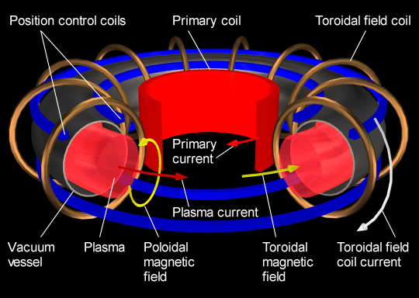
Il TOKAMAK

Slide 7
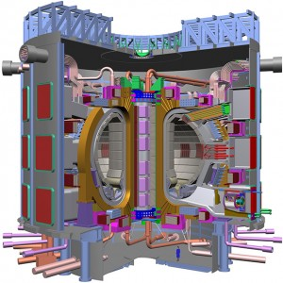

Due strade verso la fusione termonucleare: ITER e/o IGNITOR?
IGNITOR, alto campo, alta densità, tokamak
ad alto Q, mirata ad raggiungere le condizioni di
riscaldamento ohmico che consentono reazioni
nucleari autosostenentesi.
 | ITER | IGNITOR
Diam. | 29 m | 7 m
Alt. | 26 m | 8 m
PlasmaVol. | 840 m³ | 10 m³
Weight | 23000 t | 770 t
Fusion Power | 500 MW | 100 MW
El. density | ∼10²⁰ m⁻³ | ∼10²¹ m⁻³
Q=P_{f}/P_{in} | 5 -10 | > 50
Toroidal field | 5.3 T | 13 T
τ_{E} | 3.7 sec | 0.6 sec
Est. Cost | > 20 G€ | ∼ 0.35 G€
Grande ‘baco’ di ITER : valore del Q troppo basso, sperimentazione utile
per un reattore realistico, di uso commerciale è semplicemente impossibile!
Notes:
Occorre fare una tabella comparativa buona anche per il libro. ITER weight: 23000 tons, just as 3 Eiffel Towers. For higher-Q operation, ITER should be modified but this is impossible after the vessel was irradiated by D-T operation. Enormous power required by the auxiliary heating devices, due to the low 15-25% efficiency. Cohabitation of SC magnets with high power dissipation by neutrons is difficult to study in ITER, due to the short full-power operation time, (high integrated irradiation is needed). DEMO ill be suited to that.
IFMIF doesn’t seem to provide for a sufficient experimentation and test on materials (integral experiments impossible! They were made for fission reactors. Also it is still in the engineering design.
The three main issues of an ignition experiment, demonstration of confined ignition, the physics of the ignition process, and heating and control of a burning plasma, are specifically addressed by the IGNITOR experiment
Demonstration of fusion ignition is a major scientific and technical goal for controlled fusion. Until the fundamental physics of fusion burning will not be confirmed by experiments, the defining concepts for a fusion reactor will remain uncertain. Other factors would also have to be taken into account, such as the method for extracting fusion energy, self-breeding of tritium, and material technology. Nevertheless, the ignition process will be similar for any magnetically confined, predominantly thermal plasma. Heating methods and control strategies for ignition, burning, and shutdown can all be established in a near term ignition experiment.
The numbers listed in the Tables show how the risks of missing the main scientific goal of the IGNITOR project are not associated with the size and shape of the plasma column (there are several other bigger machines not listed here that operate successfully around the world), nor with the high particle and plasma current density (as indicated by the parameter BT/R). It should be pointed out that the peak density to be reached in IGNITOR, 1021 particles/m3, is ten times the density planned for ITER, but in the latter case this value is very close (80%) to the density limit, whereas it corresponds to less than 40% in IGNITOR. On the other hand, the considerably higher value of the total plasma current, and especially that of the average magnetic poloidal field BP (␣IP/5a␣1/2), are unique features of IGNITOR to ensure better confinement and a more effective barrier against plasma instabilities.

Slide 8
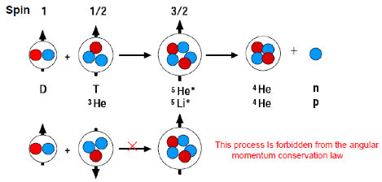
Reazioni di fusione: cinque nucleoni
Deuterio + Trizio
²H + ³H →⁴He+n + 17.58 MeV
Deuterio + Elio-3
²H +³He→⁴He+p + 18.34 MeV
Nuclei non polarizzati ➔ reattività σ = 2/3 σ_{3/2} = 2/3 del massimo modalità normale
Polarizzazione completa parallela al campo m. B ➔ σ = σ_{3/2} , He-4 e neutroni ≈ ⊥ B modalità aumentata
Deuterio polarizzato ⊥ B , T nonpol. ➔ σ = 2/3 σ_{3/2} , He-4 e neutroni ≈ // B modalità non-aumentata
Polarizzazione completa antiparallela al campo m. B ➔ σ = 1/3 σ_{3/2} He-4 e neutroni modalità soppressa
Notes:
It is an almost pure s=3/2 reaction, in a S-wave.
Θ is the angle relative to B
In the unenhanced mode alpha and neutrons are emitted parallel to B

Slide 9
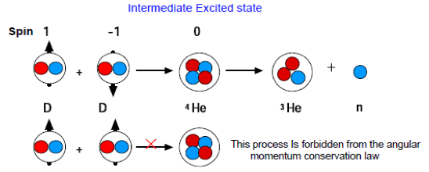
Reazioni di fusione: quattro nucleoni
Deuterio - deuterio
²H + ²H → ³He + n + 3.268 MeV
²H + ²H → ³H + p + 4.033 MeV
Reazione complicata e ancora poco conosciuta
Possibile incremento di un fattore 2-3 per orientazione trasversa ⊥ B e antiparallela // B
Soppressione di reazioni di fusione d-d nei reattori
d-t or d-³He è possible ma c’è una grave carenza di dati sperimentali
sul Quintet Suppression Factor = σ_{1,1} / σ_{T}
Notes:
The two experimental data are
The suppression comes from the fact that if the two D’s are in a S=2 state cannot approach a in L=0 S-wave which antisymmetric (?). A furthers suppression occurs because final products which are S=1/2 particles can have only S=0 or 1, so L=2 it can occur only in a 2 D-wave and this is possible only by spin-orbit or tensor forces.
In Fig.2.5 all results for the QSF from different theoretical predictions as well as from the two data parameterizations for both D + D reactions are shown. The theoretical approaches reach from DWBA calculations to very recent microscopic calculations including the Coulomb force [9, 10] and vary widely. However, these latest and most advanced calculations lend confidence to the idea that substantial suppression occurs only in the higher energy range, i. e. above the region of the Gamow peak at which fusion-energy production will preferably take place.
This is quite transparent in the distorted-wave Born-approximation (DWBA) formalism where the an-tisymmetrization of the total wave function is treated analytically.

Slide 10
Collaborazione Polfusion a PNPI Gatchina (Russia)
A. Vasilyev et al., in “Nuclear Fusion with polarized Fuel”,
Springer Proc. in Phys., Vol. 187 p. 35 (2016)

Slide 11
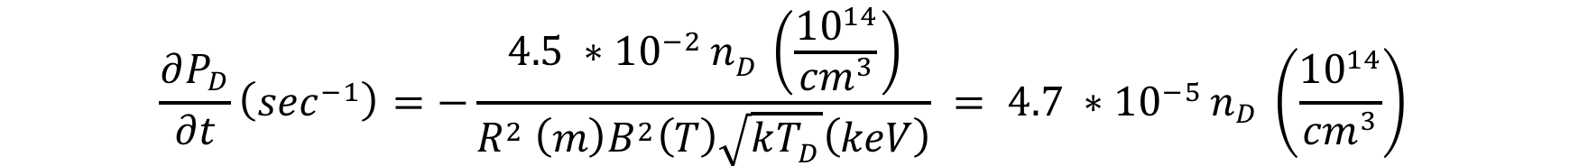
Meccanismi di depolarizzazione
Unfavorable energy balance: ΔE_{pol} ≈ 10⁻⁷ – 10⁻⁶ eV << kT ≈ 10⁴ eV but
“the mechanisms for depolarization of nuclei in a magnetic fusion reactor are surprisingly weak” (Kulsrud)
Polarization survival ∼ energy confinement time τ_{E} = 0.65 sec at B₀ =13 T for IGNITOR, (5 sec for ITER)
Ion+electron recombination: spin exchange hyperfine mixing ∝ (B_{c}/B0)² very small ≈ 10⁻⁶ sec⁻¹ for IGNITOR
Binary collisions dominated by spin-orbit coupling: dP_{T}/dt ≅ 8•10⁻⁶ , dP_{D}/dt ≅ 3•10⁻⁷ sec⁻¹
Depolarization from wall recycling: difficult to estimate, expected for non-metallic materials < 1 sec⁻¹ (¹²C no unpaired e⁻, no μ)
Field inhomogeneities for IGNITOR (B₀=13 T, R=1.32 m, kT=10.5 keV)
Resonant plasma waves: the spin-flip matrix element for ³H in a S_{z} =+1/2 is approximately given by:
=0.027 sec⁻¹ for δB⊥ ≈ 1 G, B=13 T, Ω_{p} =2π•590 MHz
A direct polarization survival measurement is needed before developing options for polarizing Tokamak fuel
Notes:
The energy conf. time: how’s it computed? Is it taken from the CDR?
Ion+electron recombination: spin exchange between electron and nucleus with polarization dilution; critical field means the hyperfine splitting energy is equal to Zeeman splitting
Binary collision are of 3 types: spin-orbit coupling for T has the largest cross-section, equal for electrons and ions; spin-spin interactions with electrons, deuterons and tritons and electric quadrupole interactions of deuterons with electric fiels give much lower values.
Wall recycling: It is generally known that interactions of the plasma nuclei with the surrounding walls represent the greatest danger to polarization. Because of recycling, depolarized nuclei re-enter the plasma, mix with the polarized ions and reduce the net polarization. It is easy to show that if the ions merely recombine on the surface of the wall and are ionized again after re-entering the plasma, then there is little depolarization because of the very strong magnetic field. (Also of interest here are the 'molecular tumbling depolarization pheno- mena' [28], which are however not discussed here.) The physics of depolarization during recycling has been surveyed by Greenside et al. [28]. They showed that the most important process was penetration of that part of the wall in contact with the plasma by the naked hydrogen nuclei. These nuclei penetrate this surface many hundreds of atomic layers and take some time to diffuse back out of the wall. During this time the nuclei are subject to fluctuating fields due to free or unpaired electrons, and subject to magnetic moments of fixed nuclei Doppler shifted by the diffusional motion of the hydrogen isotope nuclei in question, or subject to similar magnetic moments of other hydrogen isotope nuclei recycling through the wall. The authors of Ref. [28] pointed out that if the walls were made of metal, the depolarization time would be very short, of the order of milliseconds. For such walls it is clear that the plasma cannot be kept polarized under recycling conditions.
It is also pointed out in Ref. [28] that graphite is a much better wall material regarding the maintenance of polarization since there are no unpaired electrons and 12C has no magnetic moment. The depolarization time of single hydrogen nuclei embedded in graphite is 1 - 5 s. However, if many hydrogen nuclei are simultaneously embedded in the graphite, they can depolarize each other in a shorter time. This would be the case with a fusion plasma wall. Thus, with a graphite wall the depolarization could be slow enough to be acceptable. To ascertain this, it is necessary to perform experiments with actual polarized plasmas.
Field inhomogeneities: if an atom is polarized some distance from the plasma, it can be moved to the plasma through an inhomogeneous field without losing any polarization, provided the direction of the field does not rotate at a rate comparable to its precession frequency. But if the inhomogenities is combined with collisions (Lodder) this can bring to a shift of the nutation centre from the average field direction and the spin motion is a precession in a narrow cone about it.
Resonant plasma Waves: polarization states are more susceptible to variation in the magnetic field (due to excitation of collective oscillation modes –stray waves) as resonant with its precession frequency in the nucleus rest frame. This together wth wall collision seems the most harmful mechanism.

Slide 12
Questioni sperimentali
Polarized Atomic Beam Sources: max. ≈ 10¹⁷ a/s, polarization > 90%, largely insufficient for Tokamak operation: few moles with 10⁸ sec lifetimes; here Kmoles with 10 sec lifetimes required! ITER-scale reactor would require 2000 moles of D and T with 100% polarization per day!
Polarization survival must be demonstrated first, then polarized Tritium technology need development (optical pumping method, like polarized ³He for NMR) ➔ long-term R&D goal
Polarization survival observed for H₂ molecules after recombination on a inert surface like frozen Fomblin oil at 100 °K: does it work also for deuterium? Possibility of polarized D₂ molecules, frozen and stored for several hours to be injected into a Tokamak.
Present US (DIII-D, JLAB) Proposal: Use of Inertial Confinement Fusion pellets to be filled
with solid HD molecules and then frozen to m°K temperatures in high magnetic fields (> 15 T) to get high > 90% polarization
with polarized ³He from ABS to study the polarized ²H +³He→⁴He+p reaction
But: existing cryo-injection guns need upgrade for high magnetic field (15-17 T), low temperature (2°K) operation and polarization monitoring (inline-SQUID) ➔ short-term R&D goal
Notes:
ABS;
Sandorfi project

Slide 13
IGNITOR: storia recente
Long and controversial history, dating back from the late 70’s: somehow similar to ITER, but in this case the international support was missing and UE bureaucracies were adverse
1994-2000: big funding for R&D on IGNITOR assigned to ENEA by italian Parliament but no take off of the project (ENEA, MIUR, EURATOM unfavourable)
2008: investigative reporting by italian Senate, ➔ consultations Italy – Russia ➔ in 2010 a MoU between Ministries ➔ cooperation for IGNITOR project and NP, ➔ agreement for IGNITOR project on the territory of the Russian Federation.
2011: IGNITOR is a ‘Flagship’ project in the italian PNR with a 80 M€ budget
2012: INFN is entrusted the machine construction, NRC “Kurchatov Institute” for the upgrading of the existing equipment and the host infrastructure
2013: INFN and NRC Kurchatov agree on a standard evoluting path for IGNITOR
2014: joint italian-russian working group built to produce a CDR
2015 (july): CDR eventually ready and submitted to the respective political authorities
2016(september): Prof B. Coppi (IGNITOR’s inventor) officially appointed as project coordinator, but nothing else
2016 (december): conflict with the ENEA Divertor Test Tokamak (DTT) project, ancillary to ITER
2017 (summer): official (yet unpublished) decision of CIPE to split IGNITOR funding in 3 parts, one goes to CNR for project start
And now? Neither ENEA nor INFN are really committed to IGNITOR any longer. And MIUR? And Russia?

Slide 14
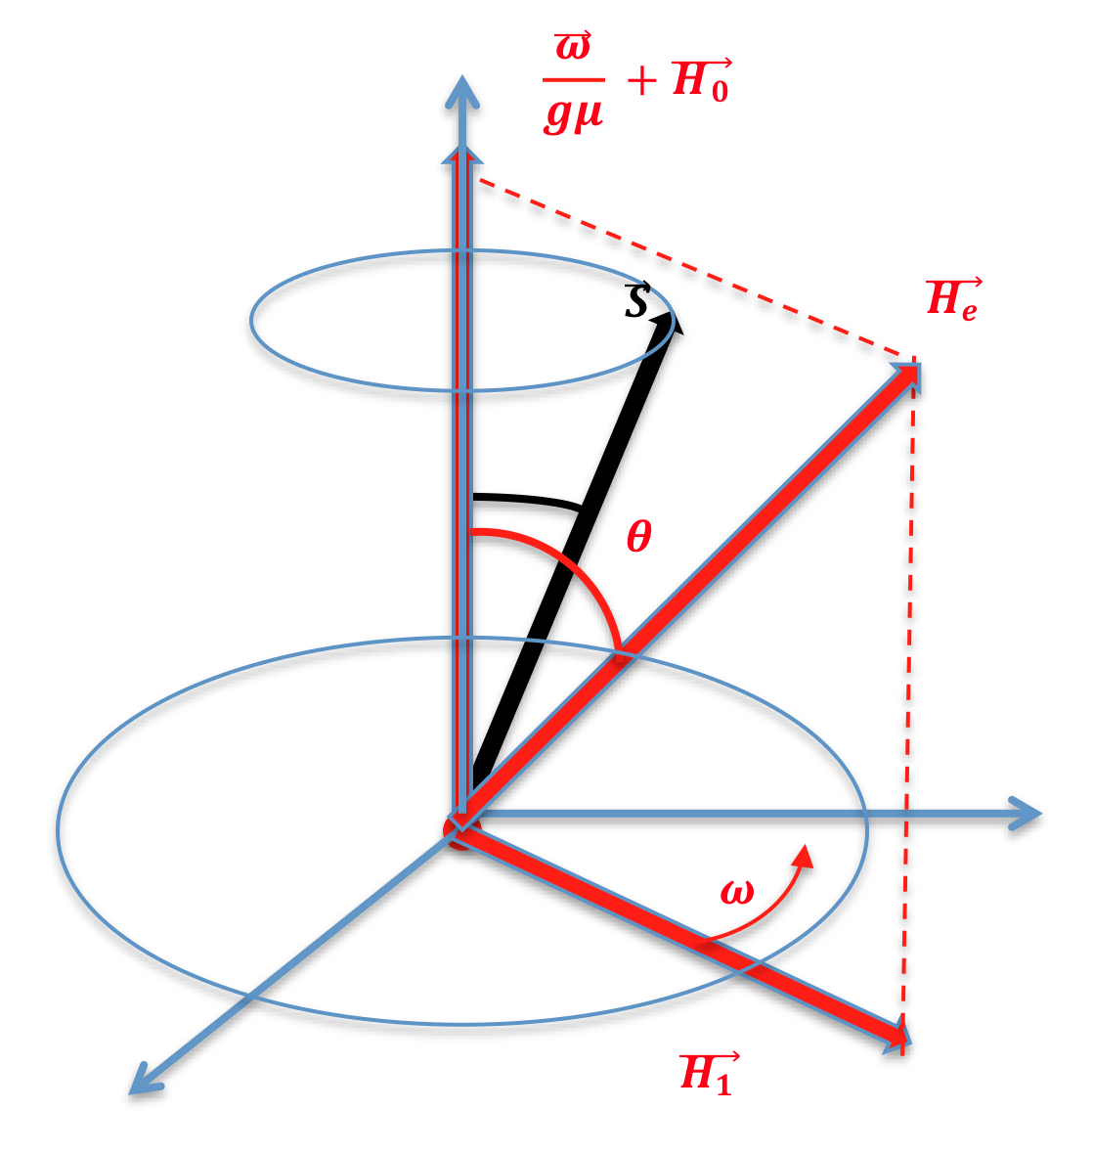
Motion of free spin
Spin motion in a magnetic field as seen in a rotating frame ( )
Adiabaticity: in a rotating frame continuously aligned along , if |ω(t)|<<|γH_{e}(t)| for any t, then
max. at resonance (θ = π/2, H_{e}=H₁), so if the initial magnetic moment is parallel to H₀, when the field varies with time, its component parallel to H_{e} will remain constant by crossing the resonance and thus end up as antiparallel to H₀. Either H₀ =H_{z} is kept constant and ω₁ is slowly varied or the inverse is possible
If there’s a distribution of precession frequencies (field inhomogenities) of width δ, all the spins are not at resonance simultaneously, so the magnetic moment component along H_{e} is still an adiabatic invariant, but its transverse value may be reduced by a factor ω₁/δ
Notes:
Trattazione classica invece di quella quantistica: possibile quando le fluttuazioni attorno al v.m. sono piccole
Come in questo caso, dove il valore medio di una variabile quantica obbedisce all’equazione classica del moto, che essendo lineare, vale anche per un grande numero di oggetti non interagenti fra loro.
The spin will precede around the resulting field He= H + ω/γ with angular velocity −α as long as H0 is slowly varying, until the resonant condition ω = −γ H0 is fulfilled, and only the precession about the perturbing field H1 survives, which looks stationary in the rotating frame if ω = ω1. The spin vector becomes “up” and “down” periodically, explaining the population of the two spin states. This is true only if there is neither spin-lattice nor spin–spin interaction.
The well-known adiabatic condition d H0 /dt ≪ γ He2 / sin θ is derived from |ω(t)| ≪ |γH(t)| and simply means that the spectrum of ω(t) does not contain frequencies comparable to γHe(t) [9].
So if the initial magnetic moment is parallel to H0, when the field varies with time, its component parallel to He will remain constant by crossing the resonance and thus end up as antiparallel to H0. Either H0 = Hz is kept constant and ω1 is slowly varied or the inverse is possible.
If there is a distribution of precession frequencies (due for instance to field inhomogeneities) of width δ, not all the spins are at resonance simultaneously, so the magnetic moment component along He is still an adiabatic invariant, but its transverse value may be reduced by a factor ω1/δ.

Slide 15
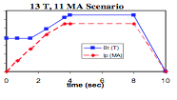
External RF fields to interact with polarization
Injecting unpolarized atoms in high magnetic field: ineffective at high temperature! fraction of nuclei contributing to NMR ≈μB/kT ≈ 3•10⁻¹¹ for D at H₀= 13T and E=10 keV.
Injecting two-states electron-polarized atomic beams and
polarizing nuclei via hyperfine transitions:
adiabaticity requires dH₀/dt<<γH₁²
field ramping-up≈2T/s
H₁ >> 5 G for D, H₁ >> 2 G for T
but injection available rate still insufficient!
Compensation of resonant depolarization by plasma stray waves: possible with special RF field with a proper bandwidth and H-component parallel to the H₀ field? Unable to cope with random perturbations. RF specialists at ENEA are presently upgrading simulation codes to include polarization
Notes:
ABS: 3-4 orders of magnitude are required!
Polarization vs energy ratio: Sandorfi
A possible scenario could be the injection of two-states electron-polarized atomic beams, as prepared by some Stern–Gerlach device, and the subsequent polarization via hyperfine transitions, induced by RF longitudinal or transverse fields. Magnetic field ramping-up is ∼ 2 T s−1 in IGNITOR [12] and the RF field should be H1 ≫ 5 G for 2H, H1 ≫ 2 G for 3H so adiabaticity requirement dH0/dt ≪ γH12 is fulfilled but injection available rate would improve by no more than a factor 10, so still
insufficient! A further possibility could be the use of RF fields to ‘compensate’ for the depo-
larization as from various non-random effects. A typical example of this is the well known Spin Echo technique which is widely used in NMR analysis [13].
Unfortunately, random perturbations as from stray waves and wall recycling seem to have the most serious depolarizing effects. Furthermore, polarization may be preserved only by a wave resonating at the proper frequency and propagating parallel to the static field H0, which would induce reversible spin-flip if the adiabaticity condition is fulfilled. But such ‘transverse’ waves are almost impossible to produce in a tokamak, a ‘parallel’ component would be always present.
For spin 1/2 particles, a magnetic field component H2 along H0 has no effect on polarization, since at resonance its contribution, which is of the order of ω2/ω0 = H2/H0 would be negligible as compared to the static field, as it is shown by a simple calculation.
For spin 1 particles, the situation is apparently similar to the well-known σ-type hyperfine transition, e.g. in an hydrogen atom, where longitudinal RF fields are used to stimulate the 􏰀mF = 0, 􏰀F = 􏰀(SZ + IZ ) = 1 adiabatic transition to populate the state with SZ = −1/2, IZ = +1/2 with high efficiency. In fact a spin 1 particle may be treated as consisting of two spin 1/2 particles, whose wave functions evolve separately but can be combined to produce the correct evolution of the spin 1 particle by a symmetrized product, where no spin 0 state is present. So it is evident that only transverse magneticfield can be used to rotate a mF =0 state into a mF =1 state.

Slide 16

Polarization in a reactor’s field
Polarization vector P= <S_{z}> = 1 for a single spin, but may average to 0 for an ensemble of spin (pure vs. mixed states).
It precesses around magnetic field in the same way as a classical magnetic dipole
If H homogeneous the parallel component of P will be conserved.
In a typical Tokamak the space dependence of toroidal and poloidal field give rise to a transverse field (to both) H₁ with components H_{1p} ≈r_{ci}H_{t}/R and H_{1t} ≈aH_{1p}/R .
This is seen by the particle as an oscillating field at ω₁ =eH₁ /m = ω_{ci} (g_{i}/2)(m_{i}/m_{p})/Z_{i} H₁/H_{t} . (Lodder, PL 98A, 179(1983))
Hence the total equation for polarization in rotating coordinates is
So the direction of ω₁ gives the displacement of the nutation centre from the average field direction and the spin motion is a precession in a narrow cone about it.
This random process leads to spin diffusion by classical mixing of their directions.
Mixing by random perturbations (collision, plasma waves) is not reversible, unlike collisionless mixing.
The perturbation need not to be at the precession frequency, but just at the difference frequency ω_{ci}- ω₀ .
Notes:
r_{ci}= cyclotron radius, R = major radius, a=minor radius, H_{t} =toroidal field
IGNITOR: r_{ci}= 1.9 10⁻³ m, R = 1.32 m , a=0.47m, H_{t} =13 T, kinetic energy=10.5 keV
The components H_{1p} , H_{1t} are given by Lodder’s approximation assuming space dependence B_{t}= B₀R/R₀ , B_{p}=rB_{t}/Rq(r)
R₀=?, R=R_{max}, r=R_{min}
spesso, al posto della trasformata rotazionale, si introduce il fattore di sicurezza, definito come:
q(r) = 2π ι
esso è il numero di giri toroidali che devo compiere per fare un giro poloidale. Se cioè la linea di campo toroidale viene incurvata di un valore ι piccolo, allora il corrispon- dente valore di q è grande.
As pointed out by Lodder [10], in a typical tokamak the space dependence of toroidal and poloidal field gives rise to a transverse (to both) field H 1 with poloidal and toroidal components H1p ≈ rci Ht/R and H1t ≈ aH1p/R, where Ht is the toroidal field, R is radial distance from tokamak axis, R0 and a are the major and minor radii of the machine, and rci is the ion cyclotron radius. Clearly, this change is seen by the particle as an oscillating field at the gyration frequency ω1 = eH1/m = ωci(gi/2)(mi/mp)/Zi H1/Ht and orthogonal to the static field (ωci, gi, mi, Zi are the ion cyclotron frequency, g-factor, mass and charge, respectively, m p is the proton mass). According to (8.1), the motion of polarization in rotating (about the average field) coordinates is given by
dP 􏰁􏰁􏰁􏰁 = (ω1 + ωci − ω0) × P = ωT × P. dt rot
So the direction of ω1 gives the displacement of the nutation centre from the average field direction and the spin motion is a precession in a narrow cone about it. This random process leads to spin diffusion by classical mixing of their directions. Mixing by random perturbations (collision, plasma waves) is not reversible, unlike
collisionless mixing.

Slide 17
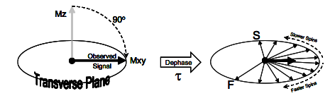
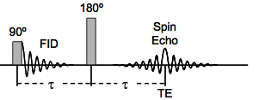
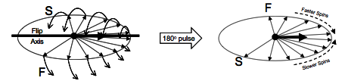
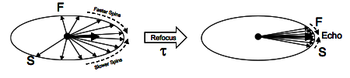
Spin echo in NMR
Hahn sequence 90º – τ – 180º – τ – echo.
Δt=π/2ω₁
Sources of reversible dephasing include:
Main magnetic field inhomogeneity
Local magnetic susceptibility
Chemical shift
Irreversible: Dephasing that relates to random processes such as spin-spin (collision) interactions or diffusion through magnetic field gradients is not reversible.
Notes:
The NMR signal observed following an initial excitation pulse decays with time due to both spin relaxation and any inhomogeneous effects which cause different spins in the sample to precess at different rates. The first of these, relaxation, leads to an irreversible loss of magnetisation. However, the inhomogeneous dephasing can be removed by applying a 180° inversion pulse that inverts the magnetisation vectors.^{[2]} Examples of inhomogeneous effects include a magnetic field gradient and a distribution of chemical shifts. If the inversion pulse is applied after a period t of dephasing, the inhomogeneous evolution will rephase to form an echo at time 2t. In simple cases, the intensity of the echo relative to the initial signal is given by e^{−2t/T}₂ where T₂ is the time constant for spin-spin relaxation.
How are spin echoes generated? Here we will return to spin diagrams:
1.Excitation Pulse and Dephasing: Individual spins in MR have such low energy that they
are not observed independently. Instead, we observe the combined signal of all the spins within the sample (or within the voxel). Immediately after the 90° RF excitation pulse, all the spins are in phase and add coherently to form the maximum signal. In real-life situations these spins start to dephase immediately as some precess faster, and some slower, than the average. As the spins move further out of phase with each other, they don’t add together as effectively, and the sum of all the spins starts to decrease (or “decay”).
2. Refocusing RF Pulse: Application of a 180° pulse “flips” the spins in the transverse plane like flipping a pancake. The spin phases are reversed: now the faster ones are where the slower ones used to be and the slower ones where the faster ones were. From this new starting point the spins continue to precess at their individual rates.
3. Rephasing and echo formation: As the spins continue to precess they are now rephasing rather than dephasing. After rephasing for a time τ equal to the original dephasing time, an echo forms:
Another popular illustration for the spin echo process involves a group of runners who all start off at the same time around the track at the sound of the first starting pistol (or excitation pulse). Rather than letting the race proceed in the normal fashion, however, a second shot of the starting pistol (the refocusing pulse) signals all the runners to instantly stop, turn around, and run back along the track in the opposite direction.

Slide 18
IGNITOR History
Nel periodo 1994-2000 il Parlamento ha stanziato cospicui fondi per il progetto IGNITOR sia mediante articoli specifici di legge, sia nell'ambito delle annuali legge finanziarie sotto forma di assegnazioni specifiche per il progetto all'interno degli stanziamenti ordinari per l'ENEA, l'agenzia nazionale per le nuove tecnologie, l'energia e lo sviluppo economico sostenibile. Tali finanziamenti hanno consentito un'intensa attività di ricerca, con il coinvolgimento anche dell'industria nazionale (Ansaldo et al.), che però non ha sfortunatamente portato al decollo del progetto, stanti forti resistenze negli ambienti scientifici di riferimento (ENEA) ma anche negli apparati politico-burocratici (MIUR, UE), che privilegiano ITER.Finalmente, a seguito di un'indagine conoscitiva sulla fusione nucleare promossa dalla VIIa Commissione Senatoriale nel 2008, il Governo di allora decise di dar vita al progetto inserendolo nelle consultazioni intergovernative con la Russia, il 3 dic. 2009, sotto la Presidenza di Berlusconi e Medvedev, rispettivamente. Con l'atto nr. PR-11 del 2 gen. 2010 il Presidente della Federazione Russa dette istruzioni al governo d'implementare le decisioni prese durante la consultazione.Le tappe successive del progetto possono riassumersi come segue:
• 26 apr. 2010: sigla di un MoU (Memo of Understanding ) tra il MIUR e il Min. dell’Educazione Russo che prevede, tra l'altro, la costruzione del reattore in Italia e la collocazione di tutta l'infrastruttura in Russia
• marzo 2011: il progetto é incluso come 'Progetto Bandiera' nel Piano Nazionale della Ricerca (PNR) 2011-2013 con un budget di 80 Mil. di € per la costruzione delreattore mentre i ministeri italiano e russo siglano un protocollo di collaborazione,
con la creazione di un comitato di coordinamento bilaterale italo-russo
• agosto 2012: la responsabilità di sviluppare la collaborazione bilaterale e di costruire il reattore viene affidata all’Istituto Nazionale di Fisica Nucleare (INFN), e analogamente viene incaricato il National Research Centre (NRC) 'Kurchatov Institute' di Mosca per la parte russa. Il MIUR crea un Comitato Internazionale di Saggi per determinare tempi e costi della realizzazione del progetto, sulla base del lavoro già prodotto dall'ENEA e dall'industria.
•marzo 2013: le conclusioni del Comitato Internazionale di Saggi quantificano il costo per la parte italiana tra i 70 e i 100 Mil. di € e sottolineano, fra l'altro, la necessità di un’adeguata struttura organizzativa, al momento non esistente
•luglio 2013: meeting tra INFN e NRC 'Kurchatov Inst.' che si accordano su una linea evolutiva 'standard' del programma, che comporta la preparazione di un Rapporto di Progetto Concettuale (CDR) , da sottomettere ai Ministeri competenti e, una volta approvato, la successiva preparazione di un Rapporto di Progetto Tecnico (TDR) con specificazioni dettagliate dei materiali e dei componenti.
•maggio 2014: formazione di un gruppo di lavoro italo-russo composto da scienziati e tecnologi per redigere il CDR
•luglio 2015: completamento del CDR, con la descrizione degli obbiettivi scientifici e degli aspetti tecnici e finanziari del progetto, e sua consegna al MIUR
Notes:
Inserire le critiche emerse dall’indagine conoscitiva

Slide 19

Ion Cyclotron Resonant Heating (ICRH) in a tokamak
ICRH is a potential source of depolarization.
Typical RF parameters
frequency 10 – 100 MHz power 2-12 MW electric field E ≈ 20kV/m magnetic induction B ≈10⁻³ T << H₀≈10 T
The use of ICRH may harm polarization, if ω = ω_{pi} ± nω_{ci} +k_{B}v_{B} Doppler-shifted to couple with spin
RF Bandwidth required ≥ [dω_{pi}/dt]^{1/2} to stay on resonance, Depolarization rate ≈
Fusion fuels (γ_{i}=ω_{pi}/2π , νi= ω_{ci}/2π ):
g_{D} = 0.86 ; γ_{D} =6.54 MHz/; ν_{D} = 7.60 MHz/T; ⏐S⏐= 1 for deuterium
g_{T} = 5.96 ; γ_{T} = 45.40 MHz/T; ν_{T} = 5.08 MHz/T; ⏐S⏐= 1/2 for tritium
g_{He3} = - 4.26 ; γ_{He} = 32.43 MHz/T; ν_{He} = 10.12 MHz/T; ⏐S⏐= 1/2 for ³He
IGNITOR: Two proposed RF frequencies 95 MhZ for 9<B₀<11 T , 115 MHz for 11<B₀<13 T (Cardinali, ENEA)
Deuterium: giration and precession frequencies quite near due to the g_{D} = 0.86
Position of resonant layer (norm. plasma radius units): x=-0.29 1st harmonic
Critical range 59 – 85 MHz for n=0, 127 – 184 MHz for n=1
Tritium: γ_{T} /ν_{T} ≈ 9 ➔ RF frequency = 590 MHz at 13 T, coupling ∝ J_{n}²(k⊥v⊥/ ω_{c}) ≈ z^{n}/(2^{n}n!),
higher harmonics suppressed for small z
Helium-3: γ_{He} /ν_{He} ≈ 3.2 ➔RF frequency = 421 MHz and critical range 72 – 105 MHz for n =-4
For neither D-T nor D-³He plasma polarization is likely to interact with ICRH
Notes:
ION CYCLOTRON RESONANT HEATING
There is a further depolarization mechanism not considered by Kulsrud et al.: the ICRH RF power waves.
The position of resonant layer is very important to decide the interaction possibilities with precession frequency.
Since waves are absorbed mainly by the left hand circularly polarized component of an electromagnetic wave at its cyclotron frequency (unless the temperature of the plasma ions is very high, of the order of 100 keV or more), it will be necessary to seed the pure deuterium target plasma with a second ion species (minority species) for its cyclotron absorption by the wave.

